Slide 1
How do we make an impact? Implementing health psychology research
Dr Julie Bayley CPsychol
Director of Research Impact Development & Director, Lincoln Impact Literacy Institute (LILI), University of Lincoln, UK
Honorary Clinical Associate Professor Nottingham University Hospitals
Email: jbayley@lincoln.ac.uk • Twitter: @JulieEBayley
Website: lili.blogs.lincoln.ac.uk • Personal blog: juliebayley.blog

Slide 2
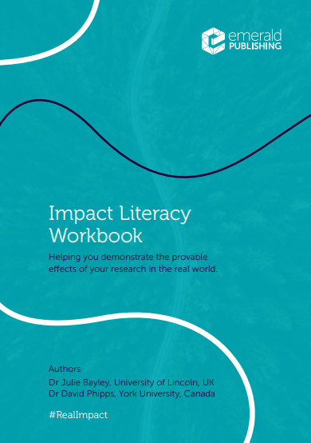
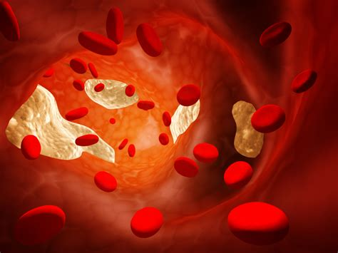
My lens….
(Previously)
Policy Lead

Slide 3
What do you want from the session?
Mentimeter
Notes:
Understanding what impact is
Planning
Generating impact
Proving impact (evidence)
Building impact into a career
Impact for REF
Something else

Slide 4
Session
What is impact
Drivers of impact
Impact Literacy
Why
Who
How
What (including evidence)
Principles
Impact and you
Apply this to you and your context

Slide 5
What is impact?

Slide 6
Impact =
Provable effects (benefits) of research in the ‘real world’
X
Not dissemination, academic interest or reputation, citations, attention

Slide 7
Impact is change
Reduced, less, lower…
Increasing something
eg
Health
Wellbeing
Efficiency
Engagement
Access
Skills
Reducing something
Eg
Mortality
Morbidity
Risk
Cost
Stress
STOPPING or PREVENTING something

Slide 8
What can we change? In health, for example…
Physical health
Wellbeing
Pain
Prevention
Quality of life
Independence
Autonomy
Confidence
Stigma
Staff wellbeing
Service sustainability
Self care
Pain
Medication use
Independence
Autonomy
Confidence
Cost savings
Staff wellbeing
Service sustainability
Service use
Service engagement
Cost savings
Feeling validated…
Policy change

Slide 9
Types of change
Conceptual
Change in the way something is thought about
Capacity building
Change in the ability to do something
Instrumental
Change in a thing
See: https://esrc.ukri.org/research/impact-toolkit/what-is-impact/

Slide 10
Some myths
Impact only happens after the research (or publication)
Impact is an endpoint
Only applied research has impact
You can’t plan impact

Slide 11
What drives impact?
Within academia:
Funders requirements
Research Excellence Framework
Knowledge Exchange Framework
Institutional ‘mission’
Sustainable Development Goals
In practice:
Patient focused goals
Practice based goals
NHS (or similar) targets
Evidence based practice
Impact as purpose

Slide 12
Article 27
Everyone has the right freely to participate in the cultural life of the community, to enjoy the arts and to share in scientific advancement and its benefits.
https://www.un.org/en/about-us/universal-declaration-of-human-rights
@researchimpact

Slide 13
External drivers: Funders
Impact as requirement for many funders, typically with focus on:
The need (‘so what?’)
How the research contributes
Who/what benefits
Planned engagement / knowledge mobilisation / coproduction / implementation strategies
Markers of success / ‘indicators of impact
Terms include: Return on Investment, Impact, Engagement, Usable, Applicable, Benefit, Improve,
Remember: often academic and non-academic reviewers

Slide 14
External drivers: Assessment
Research Excellence Framework (UK)
UK Dual funding structure:
Competitive bids (Research councils)
Quality Related (QR) funding – via REF
7(ish) yearly assessment of research outputs + environment + impact
Submitted in ‘Units of Assessment’
Impact Case Studies:4 page accounts of research at the institution → impact within certain dates & other eligibility requirements
Assessed by academics / non-academics
Marked on Reach and Significance (Unclassified to 4*)
See https://results2021.ref.ac.uk/impact
Notes:
2001/8 Research Assessment Exercise (RAE)
Outputs (eg. research papers) and environment (eg. research degrees awarded)
2014 REF (see http://impact.ref.ac.uk/CaseStudies/)
+ Impact introduced in 2011
Judged on reach and significance
2021: Worth 25%
2028??????

Slide 15
An impact case study is essentially a detailed version of this:
“We did research on ________. We connected this research to society by_____________. Because of this research, _________ changed, as demonstrated by________”
Notes:
Legitimate
Reasonable

Slide 16
Health Psychology is RICH with impact potential
We’re hardwired to drive change!
Behaviour change
Interventions
Practice
Outcome and process evaluations
Understanding ethics and power relationships
Frameworks for translating theory into practice
(etc)

Slide 17
Impact Literacy
WHY
The purpose / reason
HOW
The methods
WHO
The stakeholders
WHAT
The benefits (impacts)
Notes:
Impact literacy is the ability to understand the WHY, WHAT, WHO and HOW of impact to help generate meaningful and realistic benefits for society

Slide 18
Why and How

Slide 19
Engagement is key Question: Why should we engage?

Slide 20
Why engage?
To understand
what’s needed
the opportunity
To identify
‘market readiness’
(and embed) values
To find
a research partner
a translation partner
To explain
To set up an implementation path
As a duty
Practical
To fuel
Onwards research use
Societal use
Ethical
To build trust
Notes:
To minimise ‘cold calling’ at the end of research
Reduce mismatch between what’s done and what matters
Ensuring patient relevant issues aren’t overlooked
Reduce waste of resources
Improve quality and relevance
Reminded to avoid jargon
Richer understanding of condition
Expansion of research opportunities and scope
Increase trust in research
Ensures guidance reflects patient decision making
Makes research more ‘implementable’

Slide 21
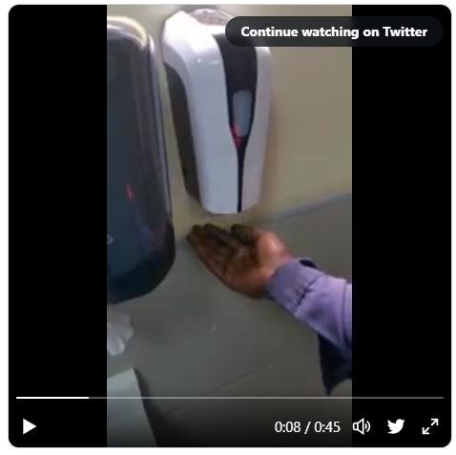
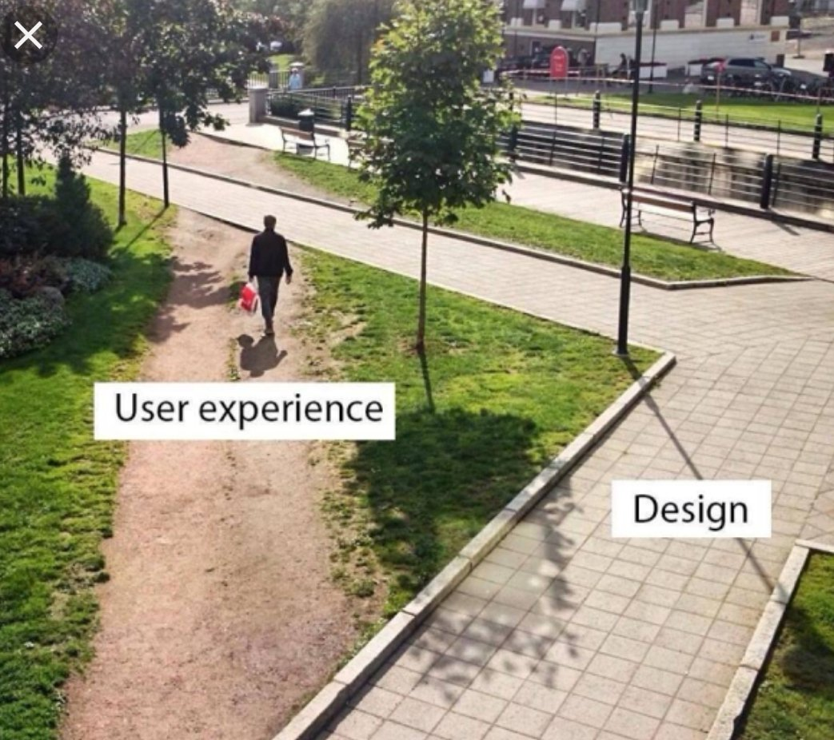
Notes:
https://twitter.com/nke_ise/status/897756900753891328?ref_src=twsrc%5Etfw%7Ctwcamp%5Etweetembed%7Ctwterm%5E897756900753891328%7Ctwgr%5E7426ab9df7f713fc81738024e611196fc85d4440%7Ctwcon%5Es1_c10&ref_url=https%3A%2F%2Fgizmodo.com%2Fembed%2Finset%2Fiframe%3Fid%3Dtwitter-897756900753891328autosize%3D1
Military/protective armour
Phone size

Slide 22
Creating impact
Engage
with stakeholders
Understand
the ‘need’
Identify
how your research contributes to a solution, what people want/need, and how it can realistically happen
Align
Activities, aims, formats, resources (etc) with the need AND the situation
Assess
Barriers, facilitators and opportunities
Be active
Connect, engage, monitor
How do we drive impact?
The simple version…!

Slide 23
Challenges
No one size fits all
Requires engagement and translation
Research closer to vs further from ‘impact zone’
May need de-implementation
May meet with resistance & changeable environments
Research-to-impact time lag

Slide 24
Health psychology interventions through an impact lens….
Problem formulation
Intervention development and testing
Attention and consideration
Uptake
Embedding
Scaling
Continued use
Repetition
Transference
Conversion
Conceptual anchor
New or replaced behaviour
Engaging individual users
Pre-intervention
Theory development
Building, validating and revising the intervention
Needs assessment
Engaging service leads
New or replaced service
Integration into system
Contribution to impact
Set change goals
Benefits to those involved
Benefits to users
Benefits to service
Connecting
Impact lost where…
Misaligned problem
Ineffective intervention
No buy in
Loss of interest
Not translatable
Notes:
Pre-intervention
Theory development, modelling and extension
Problem formulation
Research focused on identifying a problem (need), either through i) theoretical exploration, modelling or expansion and/or ii) consultation with stakeholders
Intervention development and evaluation
Activities to design and test an intervention to address a formulated problem, drawing on a specific or cluster of theoretical constructs
Attention and consideration
Process of key stakeholders becoming aware of the intervention and forming an intention to use/implement it
Uptake
Process of the intervention being used by individuals or within the health system
Embedding
Deeper integration, habituation or otherwise ongoing use of the intervention
Scaling
Increasing the reach of the intervention, translating it for new audiences or otherwise engaging new users beyond the original rollout
Repetition: Same audience (e.g. Self management for cancer → more patients)
Transference: Different audience (e.g. Self management for cancer → MS = different patients)
Conversion: Different format (eg group to online)

Slide 25
Scaling up an intervention
INTERVENTION | AUDIENCE
 | Same | Different
Same | Replication | Transfer
Different | Conversion | Conceptual anchor
Notes:
Scaling is the action of usage beyond the initial audience(s) and, whilst often not expressed within implementation models of intervention development, it is a common characteristic aspect of impact pathways. Scaling can be conceptualized as a function of a change in audience, format or both ie:
Replication: The same intervention is used with more of the same audience (eg. more patients with the same condition)
Transference: The same intervention is used with different audiences (eg. patients with different conditions)
Conversion: The intervention content and audience is the same, but the format is altered (eg. changing a group programme to online provision – eg Bayley, 20XX)
The terminology is not presented to suggest scaling is simple or restricted to one category. It is instead designed to offer poles along which developers can conceive how intervention reach can be extended. It should be noted that there is also a fourth, more loosely based mechanism of scaling, that of the conceptual anchor, wherein the intervention, or aspects of it, underpin conceptual innovation, forms the basis for the development of a new interventions/leading to use in a different way/different purpose

Slide 26
Engaging with Parliament (selected highlights)
https://www.parliament.uk/get-involved/research-impact-at-the-uk-parliament/ways-to-engage-with-parliament/
Select Committees
Cross-party groups of MPs and Peers that scrutinise different areas of Government. Use research to carry out inquiries on different topics, write reports and make recommendations to the Government.
Give evidence
Provide specialist advice
Contribute to a briefing
Contribute to a ‘POSTnote’
Peer review
Library
POST briefings
Contribute to events
Make your research findable
Public Bill Committees
Established to consider specific bills (proposed changes to the law). Research can support the scrutiny of a bill by increasing MPs' knowledge and understanding of the bill, or highlighting key issues raised by the bill and the likely implications and outcomes.
Libraries
HoP and HoL libraries, drawing on academic research to produce briefings and debate packs.
Parliamentary Office of Science and Technology (POST)
Serves both Houses and produces short briefings to provide evidence on policy and topics likely to be of future interest
All-Party Parliamentary Groups (APPGs)
Cross-party groups of MPs and Lords who share a common interest and wish to exchange information or inform debate around that topic. They do not have an official status within Parliament.

Slide 27
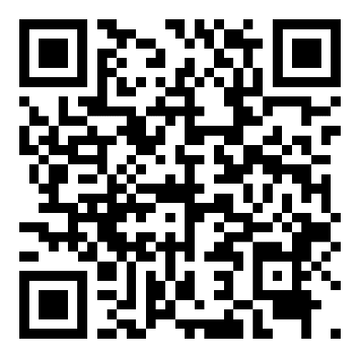
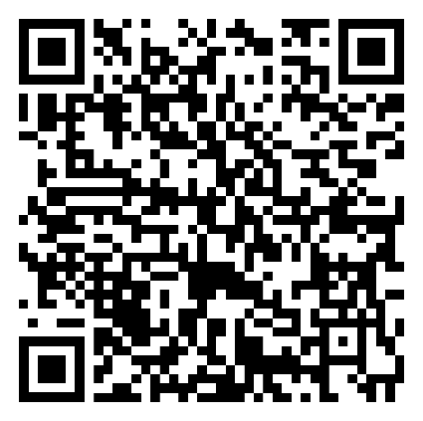
DHSC Consultation on Major conditions Strategy - Call for Evidence
The Department of Health and Social Care (DHSC) has launched a call for evidence to inform the development of the major conditions strategy to tackle ill health and ease pressure on the health system. They are seeking views on how to prevent, diagnose, treat, and manage the groups of major conditions, namely:
cancers
cardiovascular diseases (including stroke and diabetes)
chronic respiratory diseases
dementia
mental ill health
musculoskeletal disorders
+ how to tackle behavioural risk factors common to the major condition groups
+ how to improve the care and outcomes
DHP will be submitting a joint response with partner organisations
Submit directly and/or contribute to the DHP response
Deadline for DHSC: 27th June
Deadline for contribute to DHP: 20th June
Contribute directly to DHSC survey by 27th June
https://tinyurl.com/8294v2uc
Contribute to DHP & partner response by 20th June
https://tinyurl.com/yeh8duuw

Slide 28
Who should we engage with?

Slide 29
WHO?
Within a research organisation including
Research staff, leadership, impact leads, comms, public engagement, research office, policy…..(etc)
Beyond the research organisation including
Partnership agencies
Gatekeepers
Don’t forget
Competitors
Opposition
Patients
Carers
Families
Staff
Audiences
Beneficiaries
Commissioners
Policy makers
Funders
Wider stakeholders
Notes:
The answer is in the audience

Slide 30
What

Slide 31
What can we mobilise?
New knowledge, insights or evidence (‘we now know’)
New concepts, ideas or perspectives (‘we have rethought’)
Insights into ways things are understood (‘we know how we know’)
New or modified research methods (‘we know how to’)
Experiences of what doesn’t work (‘we know not to’)
A materially usable ‘thing’ such as a process, tool or intervention (‘we now have a thing for’)
A new practice or way of performing (‘we have a new way to’)
Newly heard voices, especially through coproduction (‘we’ve now heard from’)
A new definition or set of parameters (‘we can now specify’)
An output?
Notes:
New knowledge, insights or evidence (‘we now know’)
New concepts, ideas or perspectives (‘we have rethought’)
Insights into ways things are understood (‘we know how we know’)
New or modified research methods (‘we know how to’)
Experiences of what doesn’t work (‘we know not to’)
A materially usable ‘thing’ such as a process, tool or intervention (‘we now have a thing for’)
A new practice or way of performing (‘we have a new way to’)
Newly heard voices, especially through coproduction (‘we’ve now heard from’)
A new definition or set of parameters (‘we can now specify’)

Slide 32
Evidence of impact
Needed to corroborate claims of research-led change
Qualitative or quantitative
Commonly consists of several pieces which collectively corroborate the claim(s)
Stronger when externally voiced, from a legitimate source, aligned to claim
No template, but common types include:
Testimonials
‘Data’ (survey, service access, visitor numbers…)
Policy citation
Practitioner guidance change
Organisational reports
(ie. something that proves the change)

Slide 33
Impact and you
What can you do to build your impact literacy?

Slide 34
Your CV already reflects impact…
Knowledge mobilisation and engagement [engagement skills]
Activities to show the benefit of eg. workshop surveys [evaluation skills]
Implementation of research or interventions [implementation skills]
Tracking how research is used in practice [monitoring skills]
Building partnerships with non-academic organisations [partnership skills]
Contribution to a case study [REF skills!]
Mapping a change process [planning skills]
Creative feedback to non-academics [Communication skills]

Slide 35
Weaving impact into your career
Connect into networks which are focused on change
Skill-up
Shift beyond dissemination
Dive into implementation science
Check out examples of impact
Connect with the people who are making a difference
As a researcher
As a practitioner
As a teacher
As a mentor
As a leader
As a mix

Slide 36
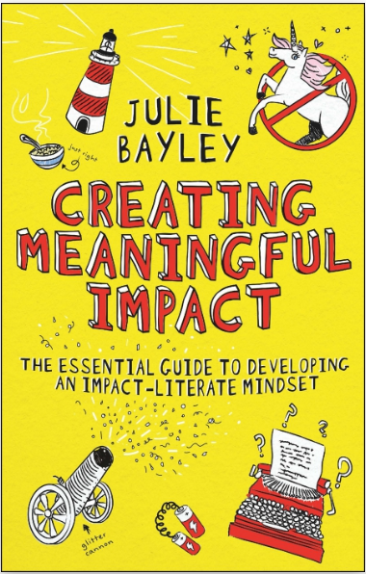
TOWARDS HEALTHIER: principles for impact literacy in practice
https://books.emeraldinsight.com/book/detail/creating-meaningful-impact/?k=9781804551929

Slide 37
Chase meaning not unicorns
Focus on what matters, rather than what’s mythically shiny and impressive
When you get close it might just be an ugly horse wearing a hat
Notes:
Impact becomes a mystical, mythical and magical beast – an impact unicorn – where instead of focusing on the actual changes we can make (or those we can get on a path towards), we lock our targets on prestige. Unicorns exist when we put glory before what matters.

Slide 38
Work out what your research powers up
What would be different if your research didn’t exist?
Not all heroes wear capes. And Power Rangers are cool.
Notes:
Translate this analogy to your research. What would be different if your research didn’t exist? Mentally subtract your research from the picture and see what would be impossible, weaker, remain locked or otherwise be a problem. The difference is what you power up. The difference is impact.

Slide 39
Evidence? Think ‘what would Jessica fletcher do?’
Be a detective: Ask questions, collect the clues and assemble the case.
Do Do Do Do Dooooooo Do Do Dooo Do Doooooo
Notes:
Spotting the clues, asking the right questions and building a picture which unquestionably points to the truth. And this is weirdly analogous to impact. Sometimes we have to hunt for evidence, sometimes it lands on our lap, and sometimes we have to consider how we can determine the truth in the absence of harder facts.

Slide 40
Own your expertise but don’t be a jerk
Recognise the value you bring, as well as the expertise of others.
Not too hot, not too cold, but just right. And let’s overlook Goldilocks’ penchant for breaking and entering

Slide 41
Be you
Always, and with pride.
Unless you’re a jerk

Slide 42
We all have the chance to make a difference How great is that?

Slide 43
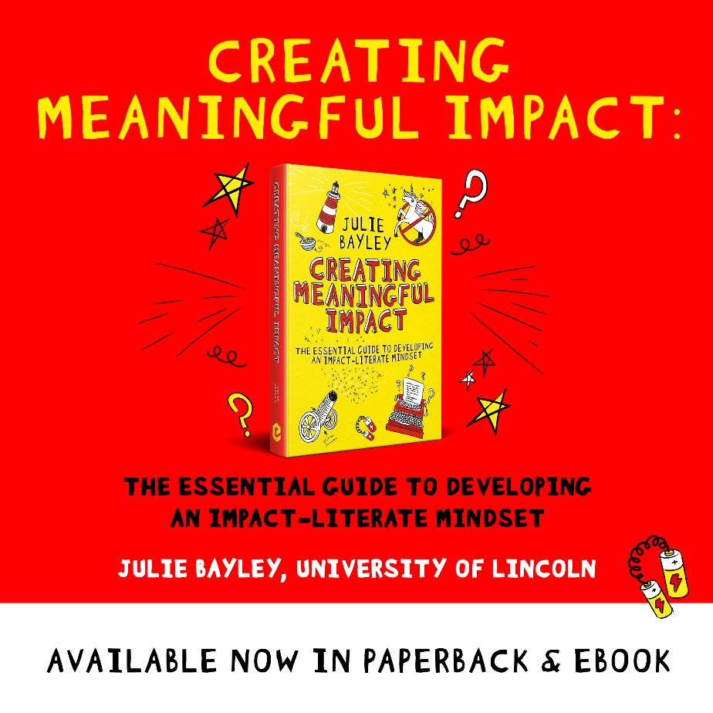
Thank you
Contact
Twitter: @JulieEBayley
Blog: juliebayley.blog
Email: jbayley@lincoln.ac.uk
Lincoln Impact Literacy Institute (LILI)
Twitter: @impactLILI
https://lili.blogs.lincoln.ac.uk/
Notes:
Twitter: @JulieEBayley
Blog: juliebayley.blog
Email: jbayley@lincoln.ac.uk
Lincoln Impact Literacy Institute (LILI)
Twitter: @impactLILI
https://lili.blogs.lincoln.ac.uk/
Available on
Amazon
Bookshop.org
See:
https://books.emeraldinsight.com/book/detail/creating-meaningful-impact/?k=9781804551929

